Slide 1

Does our skill at citizen science change with time?
Visions of Science 2021

Slide 2
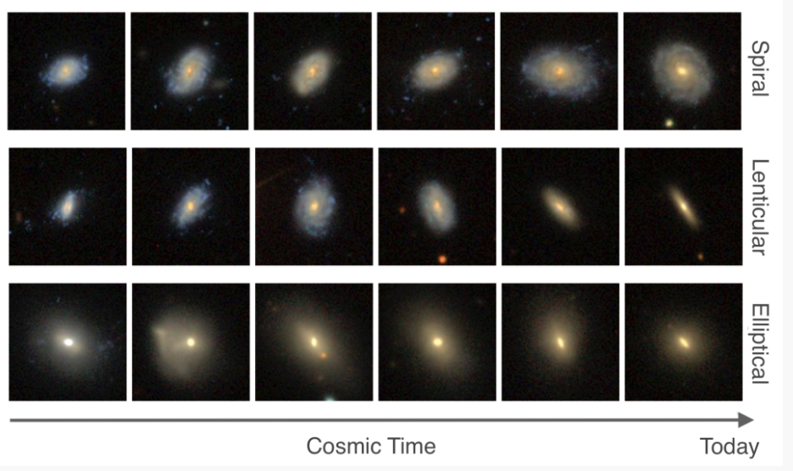
Galaxies do not all look the same!

Slide 3
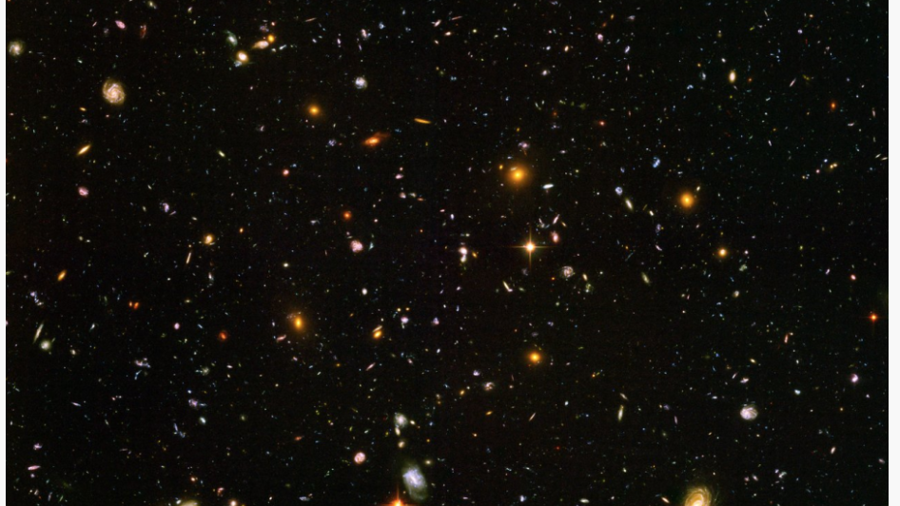
There are lots of galaxies in the universe

Slide 4
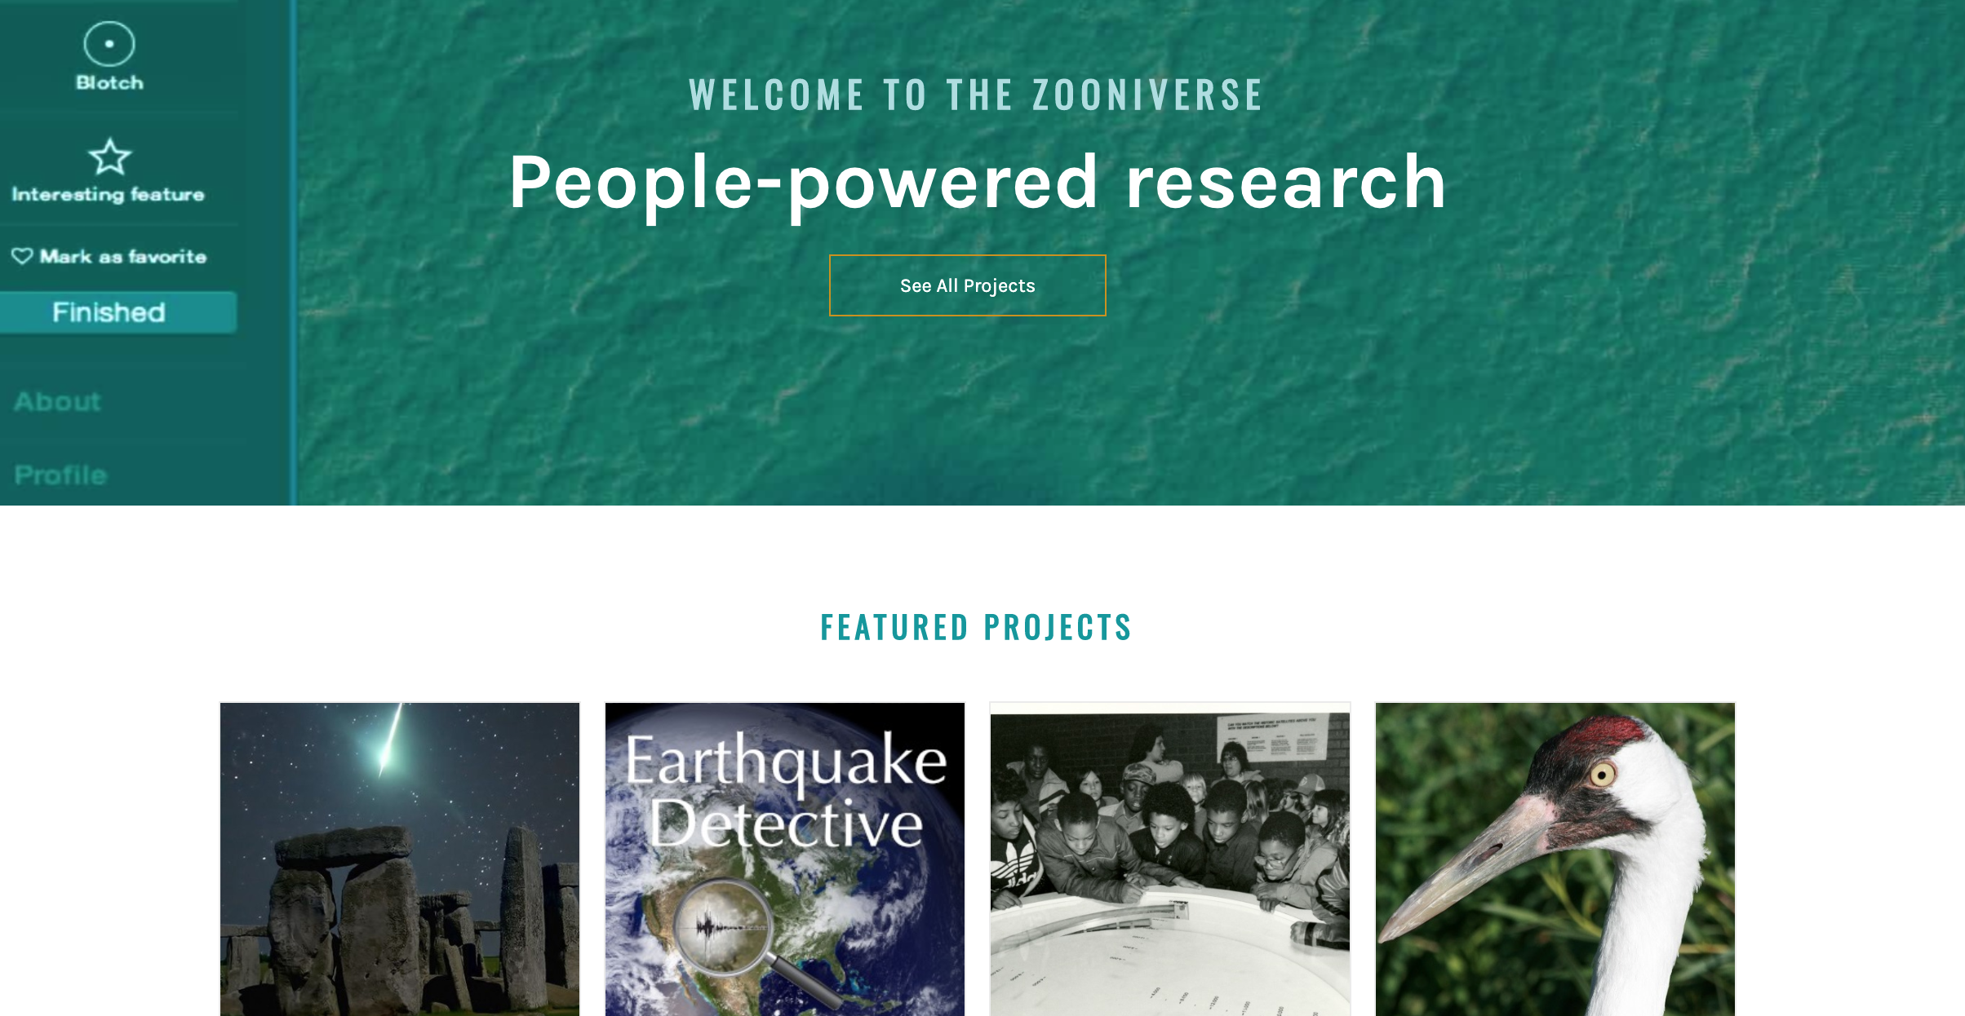

Slide 5
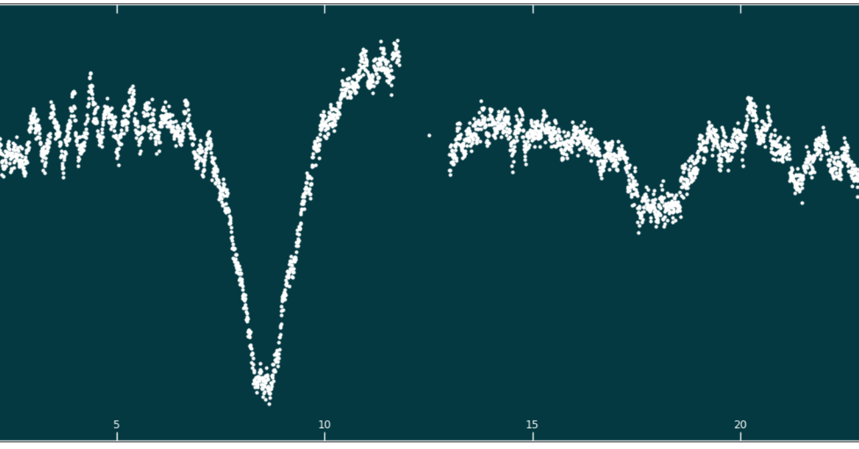
We can use the human eye/brain to search for patterns in lots of different observations

Slide 6

How does our ability to classify change with time?

